Slide 1
UNIT-V

Slide 2
UNIT – V: GRID INTEGRATION OF DGS AND TECHNICAL IMPACTS OF DGS
Different types of interfaces – Inverter based DGs and rotating machine-based interfaces – Aggregation of multiple DG units – Energy storage elements – Batteries, ultra capacitors, flywheels. DG Impact on - Transmission and Distribution systems, De-regulation – Impact of DGs upon protective relaying –Impact of DGs upon transient and dynamic stability of existing distribution systems

Slide 3
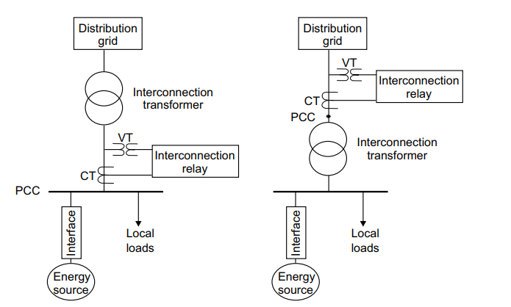
INTERFACE WITH THE GRID
The connection point of an energy source to the grid is usually referred to as the point of connection (PCC).
Its definition depends on the ownership and utility interconnect requirements.
Two different possible definitions are shown in Figure , where typically the interconnection relay (protection) is installed at the PCC .
It will be assumed here that the PCC is the connection point before the interconnection transformer (the left-hand schematic of the figure). The technology that connects an energy source to the PCC, which is referred to as the interfacing technology, may comprise another transformer.
Figure: Two possible definitions of the point-of-common coupling (PCC).

Slide 4
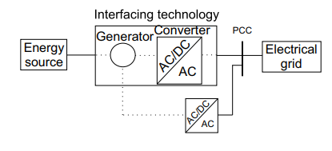
There are different interfacing technologies used; in common is the use of generators and power electronics converters, as shown in Figure .
The main goal of the interfacing technology is to accommodate the energy produced to the grid requirements.
Figure :Interfacing of energy sources with the grid.

Slide 5
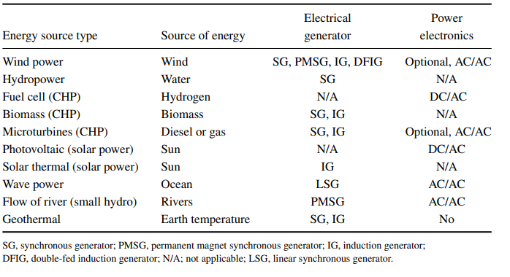
Depending on the nature of their produced power, different energy sources use different technologies to interface/couple with the grid, as reported in Table .
TABLE : Interfacing Technologies for Different Energy Sources

Slide 6
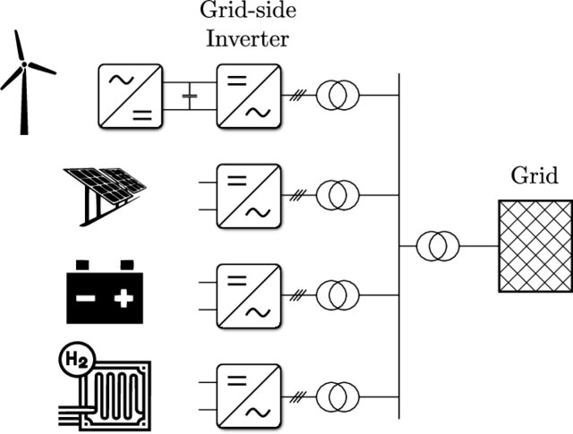
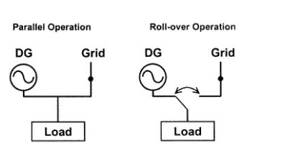
Interfaces to the utility system
DG units are interconnected with the utility to operate in parallel with its distribution system.
The main type of electrical system machines/interfaces are synchronous generators, asynchronous generators (induction machines) and power electronic inverters.

Slide 7
Synchronous machines
The majority of DG units interconnected for parallel operation with utility distribution system are three-phase synchronous machines.
Synchronous generators use DC field for excitation, and hence they can produce both active and reactive power. Emergency back-up generators using fossil-fuels combustion engines are normally synchronous machines.
The machine can follow any load within its design capability with suitable field control. Besides, the inherent inertia, relatively small in the case of DG units compared to traditional generators, allows it to tolerate any step changes in the load.
Being capable of producing reactive power, large synchronous generators, relative to utility system capacity, might act as voltage regulators to improve voltage profile across the distribution feeder to which they are connected.
However, these generators should be coordinated with utility voltage regulators and protection equipment to avoid any operating conflicts such as over-current protection, voltage regulation and others

Slide 8
Asynchronous machines
Asynchronous machines, also known as induction machines can be used as induction generators by driving the rotor slightly faster than synchronous speed.
They are often started as a motor using the utility power line. For weak systems, the prime mover is started and brought to near synchronous speed before the machine is interconnected.
Induction generators are typically smaller than 500 kW and they are suitable for wind DG units. They are easily interfaced to the utility as no special synchronizing equipment is required.
Unlike synchronous generators, induction generators are capable of producing active power only, and not reactive power.
They require reactive power, from the power system to which it is connected, to provide excitation. This might affect the utility voltage and result in a low-voltage problem. Capacitors are then installed on the induction generator side to supply required reactive power to avoid any problems.

Slide 9
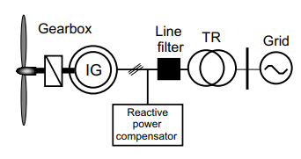
Figure : Direct induction generator coupling for a wind turbine.

Slide 10
Power electronic inverters
An inverter is a solid state device that converts DC to AC at a desired voltage and frequency.
DG technologies that generate either DC (wind, fuel cells and photovoltaic) or non-power frequency AC (micro turbines) must use an inverter to interface with power systems.
The inverter technology has changed from the early thyristor-based, line commutated inverters to switched PWM inverters using insulated gate bipolar transistor (IGBT) switches.
The shift in technology has greatly reduced the amount of harmonics injected by these inverters to the utility system.
Power electronic inverters produce power at unity power factor to allow the full current-carrying capability of the switch to be used for delivering active power.
When trouble is detected, the inverter can be switched off very quickly (in milliseconds) unlike the rotating machines which may require several cycles to respond

Slide 11
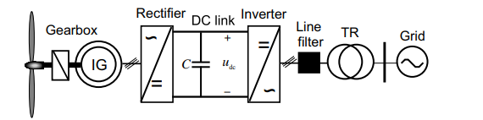
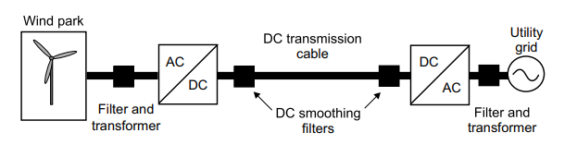
Figure : Full power electronics interfaced wind turbine with induction generator
Figure : DC power transmission for a wind farm.

Slide 12
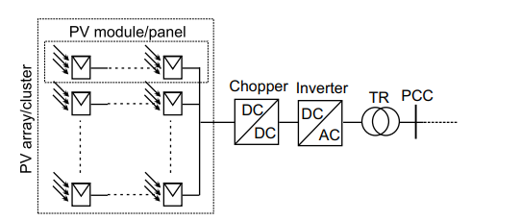
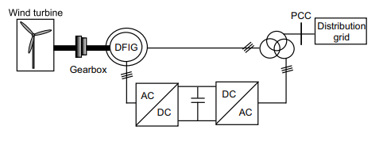
Figure : Conventional photovoltaic array interface to the grid
Figure :Double-fed induction generator connection of a wind turbine

Slide 13
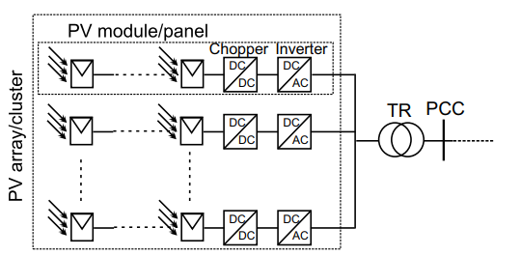
Figure : Photovoltaic array interface through modular conversion

Slide 14
Rotating machine-based interface
There is a variety of rotating machine-based DG technologies in use currently.
These include and not limited to; Small hydraulic units, with and without governor, driving synchronous generators with automatic voltage regulators, diesel units with governors and voltage regulators, wind turbines connected to the system through directly coupled induction generators, and Wind turbines connected to the system through doubly-fed induction generators

Slide 15
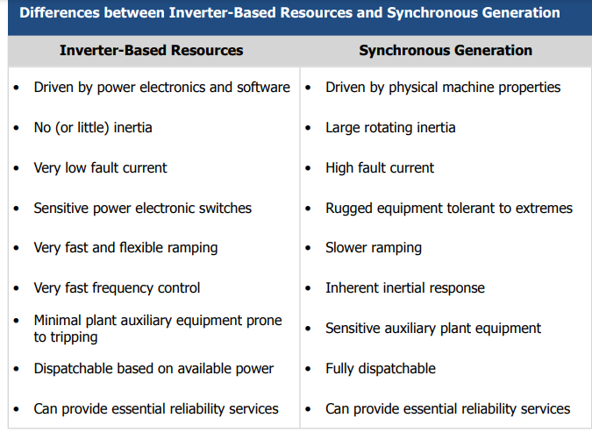

Slide 16
Impact of the Type of Interface on the Power System
The interfacing technology of distributed generation to the grid determines its impact on the distribution system operation and also the impact of different upstream contingencies on the energy sources.
Briefly, the interfacing technology impacts the system in different ways:
It determines the quality of the power supplied by the energy source. Usually the grid operator (DSO) sets certain requirements over the power quality injected by the DG. It is the DG owner responsibility to ensure that the DG technology meets the DSO requirements.
It determines the impact of different power quality on the energy source. Different interfaces have different sensitivities to different power quality events at the grid.
It determines the efficiency of the energy source. For example, using modular power electronics for solar power interfacing results in more efficient systems compared to central full power electronics interfacing.

Slide 17
It impacts the cost of the DG installation.
It determines the complexity of the DG application.
It determines the controllability of the energy source. For instance, full power electronics interfaces introduce the most controllability of all interfacing technologies since they provide independent control over active and reactive powers injected into the grid.

Slide 18
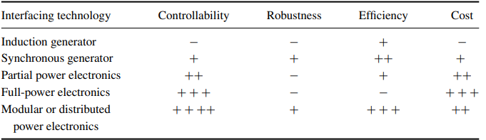
Different interfacing technologies are compared in Table . regarding their controllability. As a rule of thumb, a trade-off must always be made between the high performance of the interface and the overall cost of the installation.
TABLE : General Comparison of Interfacing Technology
“−” for Less and “+” for More.

Slide 19
Batteries
Stand-alone systems obviously need some method to store energy gathered during good times to be able to use it during the bad.
While various exotic technologies are possible—including flywheels, compressed air, or even hydrogen production—it is the lowly battery that makes the most sense today. And, among the many possible battery technologies, it is the familiar lead-acid battery.
Competitors to conventional lead-acid batteries include nickel–cadmium, nickel–metal hydride, lithium–ion, lithium–polymer, NAS-Sodium Sulphur and nickel–zinc technologies.
Of these, only nickel–cadmium “Nicads” are even barely competitive with lead-acid batteries, but this may change in the near future due to the surge of interest and development in new battery technologies for electric and hybrid vehicles.

Slide 20
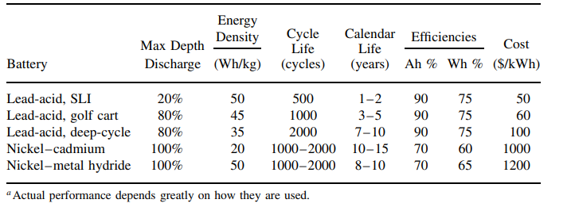

Slide 21
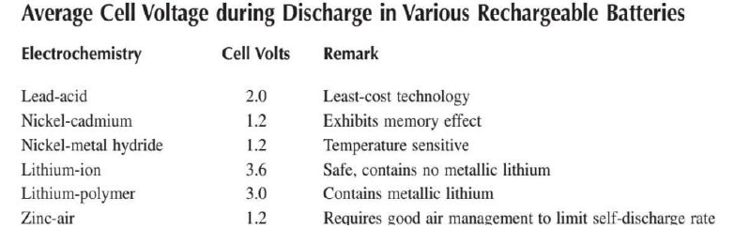

Slide 22
Basics of Lead-Acid Batteries
Lead-acid batteries date back to the 1860s when inventor Raymond Gaston Plante´ fabricated the first practical cells made with corroded lead-foil electrodes and a dilute solution of sulfuric acid and water.
Lead-acid batteries are used in everything from small electronic devices such as cell phones, to car batteries, to enormous utility battery banks, the largest of which, in Chino, California, is capable of delivering 4 h of 10 MW power (5000 A at 2000 V) into the grid.
Very simply, an individual 2-V cell in a lead-acid battery consists of a positive electrode made of lead dioxide (PbO2) and an negative electrode made of a highly porous, metallic lead (Pb) structure, both of which are completely immersed in an electrolyte consisting of a dilute solution of sulfuric acid and water.
Thin lead plates are structurally very weak and would not hold up well to physical abuse unless alloyed with a strengthening material. Automobile SLI batteries use calcium for strengthening, but calcium does not tolerate discharges of more than about 25 percent very well. Deep discharge batteries use antimony instead, and so are often referred to as lead antimony batteries.

Slide 23

The chemical reactions taking place while the battery discharges are as follows:
……(1),
……(2),
The anode is the electrode at which oxidation occurs, which means that during discharge the anode is the negative terminal, but during charging the anode is the positive terminal.
As can be seen from (2), during discharge the electrons are released at the negative electrode, which then flow through the load to the positive plate where they enter into the reaction given by (1).
The key feature of both reactions is that sulfate ions (SO2− 4 ) that start out in the electrolyte when the battery is fully charged end up being deposited onto each of the two electrodes as lead sulfate (PbSO4) during discharge.

Slide 24
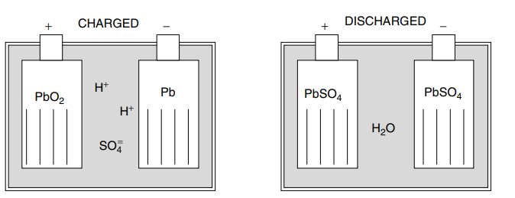
As the battery approaches its fully discharged state, the cell voltage drops sharply while its internal resistance rises abruptly.
For good battery longevity it is important to keep batteries as fully charged as possible and to completely charge them on a regular basis.
Figure :A lead-acid battery in its charged and discharged states

Slide 25
Battery Storage Capacity
Energy storage in a battery is typically given in units of amp-hours (Ah) at some nominal voltage and at some specified discharge rate.
A lead-acid battery, for example, has a nominal voltage of 2 V per cell (e.g., 6 cells for a 12-V battery), and manufacturers typically specify the amp-hour capacity at a discharge rate that would drain the battery down to 1.75 V over a specified period of time at a temperature of 25◦ C.
A 200-Ah battery that is delivering 20 A is said to be discharging at a C/10 rate, where the C refers to Ah of capacity and the 10 is hours it would take to deplete (C/10 = 200 Ah/10 h = 20 A).
For batteries wired in series, the voltages add, but since the same current flows through each battery, the amp-hour rating of the string is the same as it is for each battery. For batteries wired in parallel the voltage across each battery is the same, but since currents add, the amp-hour capacity is additive.

Slide 26
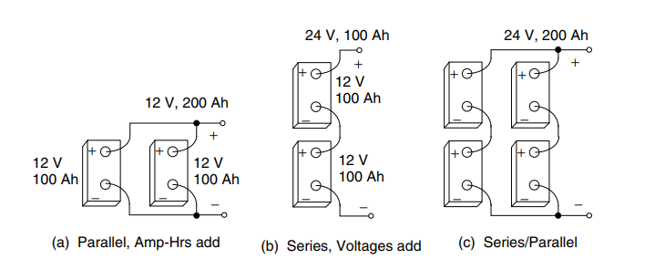
Figure : For batteries wired in parallel, amp-hours add (a). For batteries in series, voltages add (b). For series/parallel combinations, both add.

Slide 27
Batteries in series have higher voltage and lower current, which means more manageable wire sizes without excessive voltage and power losses, along with smaller fuses and switches, and slightly easier connections between batteries.
On the other hand, a storage system consisting of batteries in parallel is easy to expand, one battery at a time. In series, a whole new string of batteries must be added to increase storage.

Slide 28
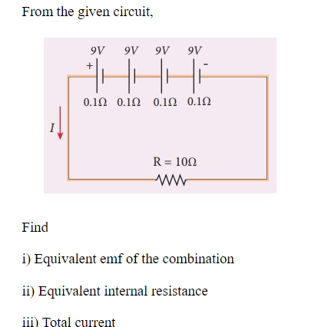

Slide 29
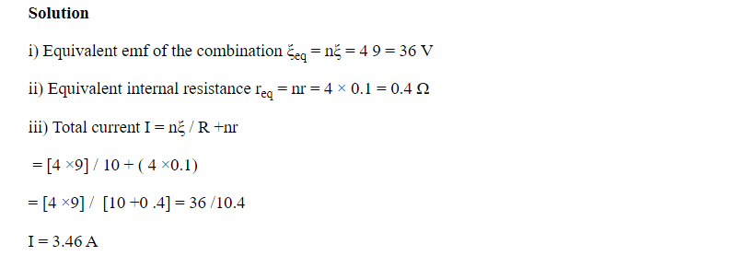

Slide 30
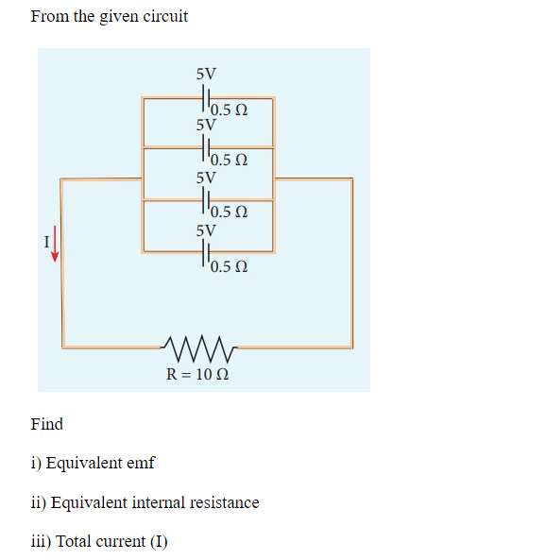

Slide 31
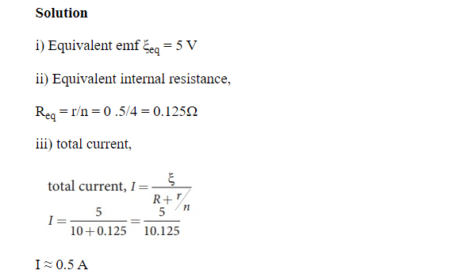

Slide 32
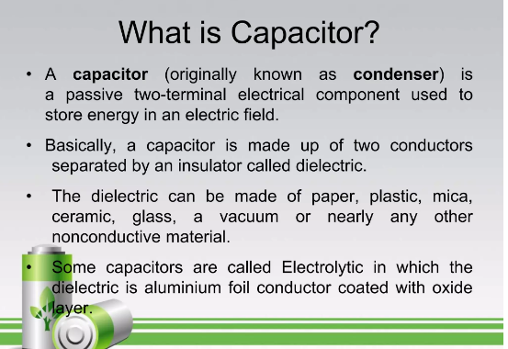

Slide 33
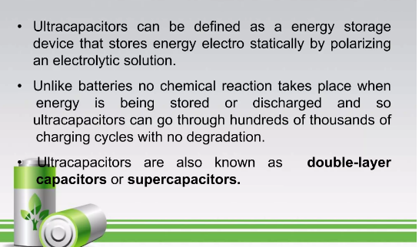

Slide 34
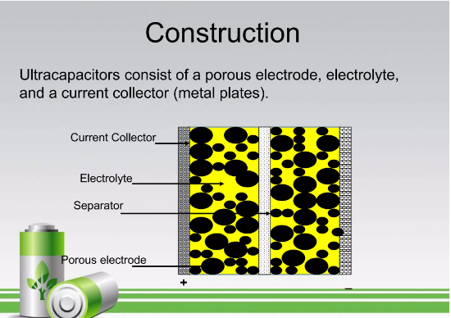

Slide 35
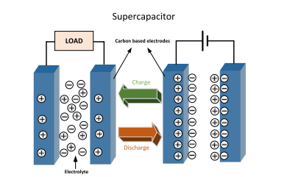
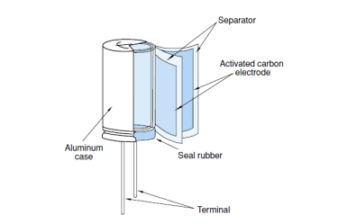
FIGURE : Supercapacitor
Figure : Cell Construction

Slide 36
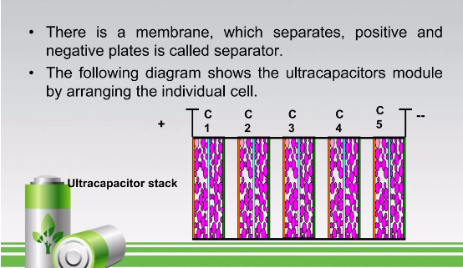

Slide 37
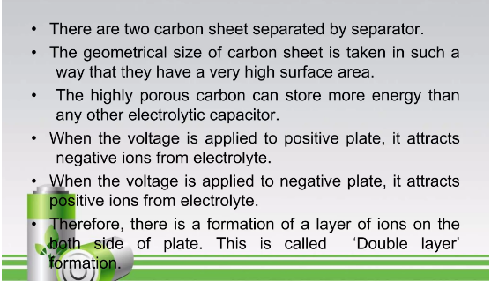

Slide 38
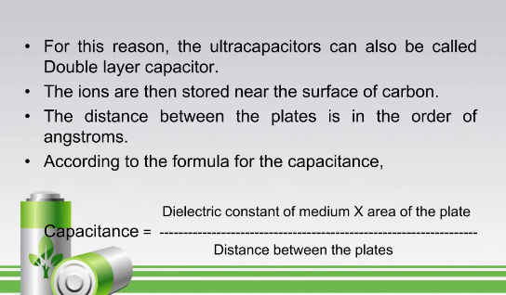

Slide 39
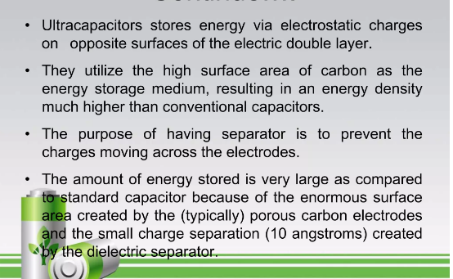

Slide 40
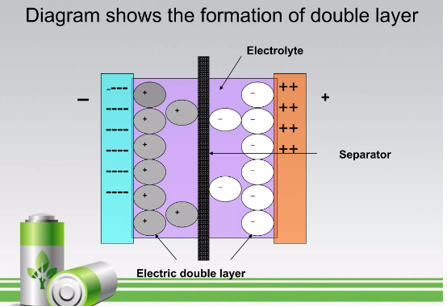

Slide 41
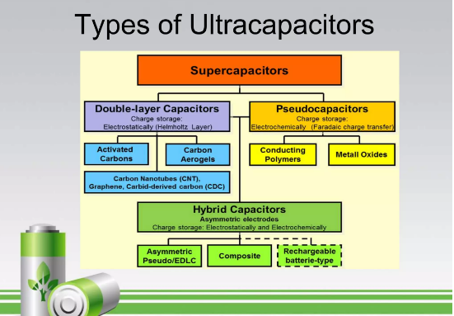

Slide 42
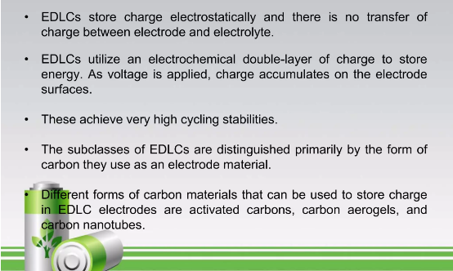

Slide 43
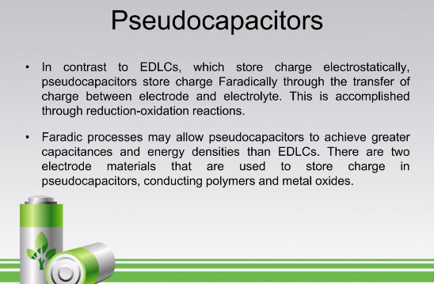

Slide 44
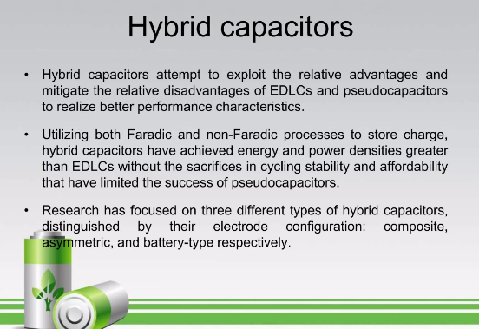

Slide 45
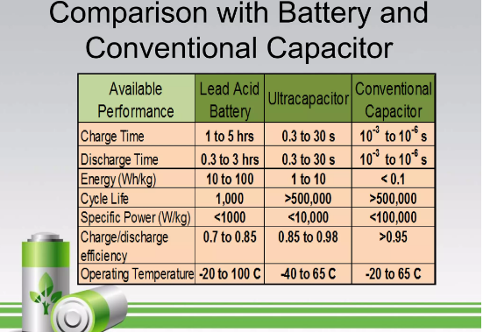

Slide 46
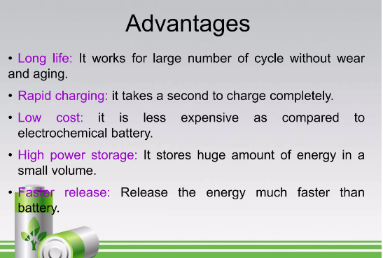

Slide 47
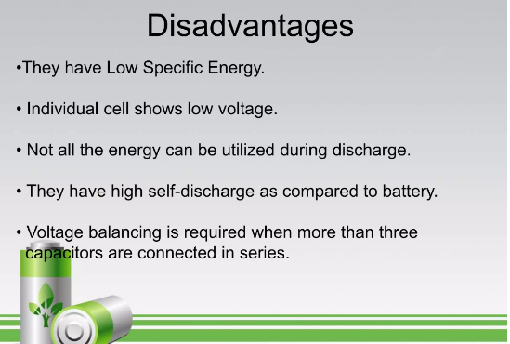

Slide 48
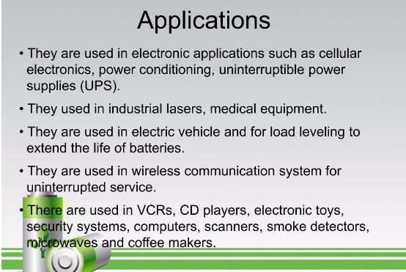

Slide 49
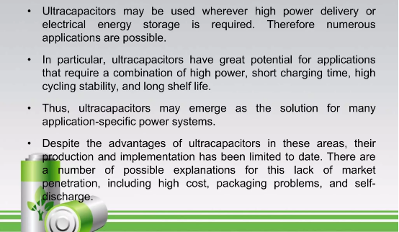

Slide 50
Through three generations of upgrading and decades of development, there have emerged a series of supercapacitor products with the capacity ranging from 0.5 to 1000 F, the working voltage from 12 to 400 V, and the maximum discharge current from 400 to 2000 A.
The maximum stored energy of the storage system can reach 30 MJ.
However, supercapacitor is quite expensive, and in the power system it is mainly used to smooth load of short time and high power and for the peak power of the electric energy quality such as the start-up support for high-power DC motors and transient recovery voltage.
It can enhance the level of electricity supply when the voltage drops and during the transient interference.

Slide 51
Flywheel energy storage
Flywheel energy storage uses electric motors to drive the flywheel to rotate at a high speed so that the electrical power is transformed into mechanical power and stored, and when necessary, flywheels drive generators to generate power.
The flywheel system operates in the high vacuum environment.
The flywheel system is made of a fiber-epoxy composite rotor, supported on magnetic bearings, rotating in a vacuum, and mechanically coupled with an electrical machine that can work as a motor or a generator. Two counter-rotating wheels are placed side by side where gyroscopic effects must be eliminated

Slide 52
Fig : Structure of a flywheel and its components

Slide 53
https://www.youtube.com/watch?v=J9slIBECva4

Slide 54
The fly wheel energy storage system (FESS) is made up of a heavy rotating part, the flywheel, with an electric motor/generator.
The inbuilt motor uses electrical power to turn at high speeds to set the flywheel turning at its operating speed. This results in the storage of kinetic energy.
When energy is required, the motor functions as a generator, because the flywheel transfers rotational energy to it. This is converted back into electrical energy, thus completing the cycle.
As the flywheel spins faster, it experiences greater force and thus stores more energy.

Slide 55
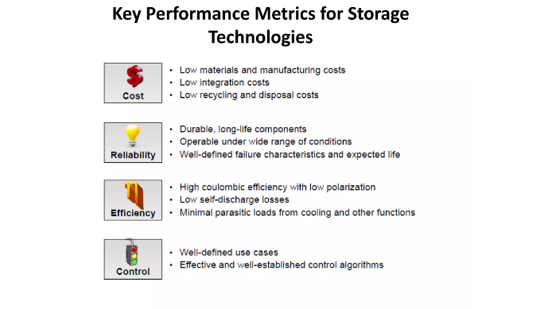

Slide 56
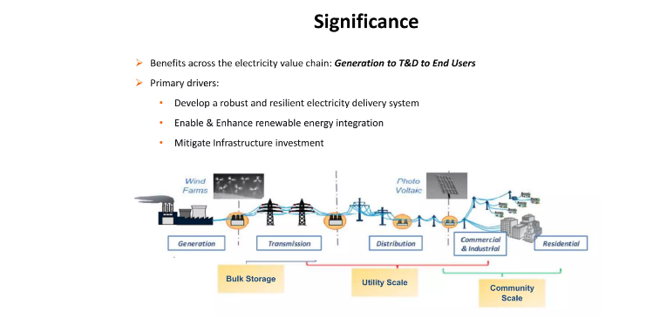

Slide 57
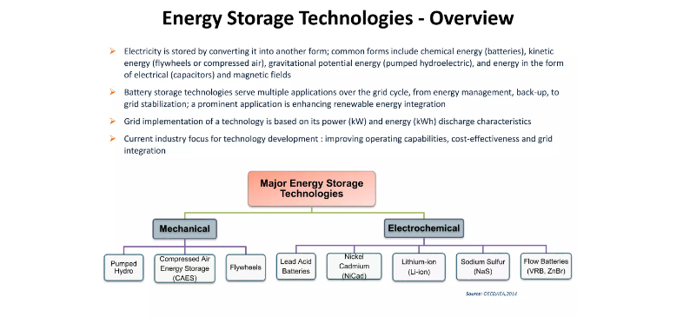

Slide 58
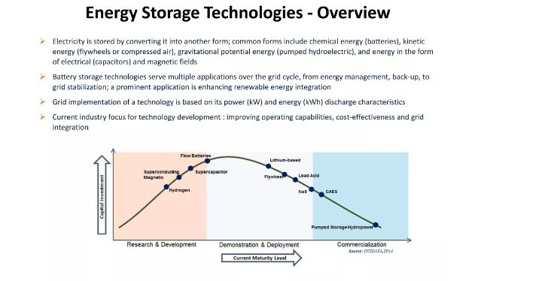

Slide 59
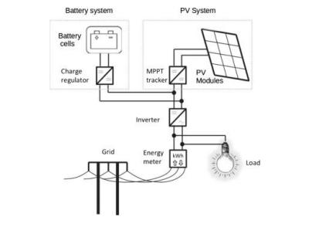
FIGURE. SCHEMA OF A PV-SYSTEM CONNECTED TO THE GRID

Slide 60
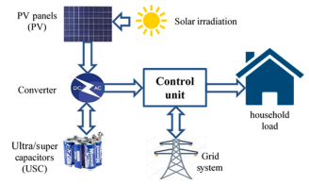
Fig: Schematic diagram of the PV/USC grid-on power system

Slide 61
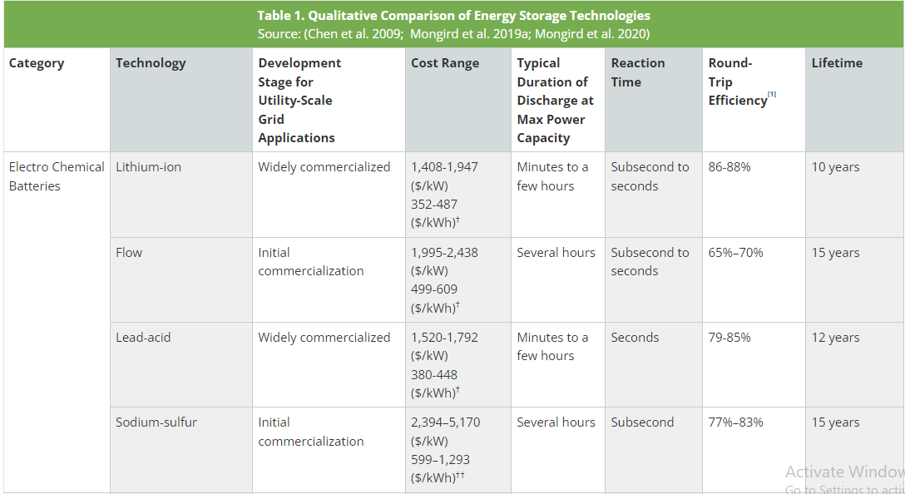

Slide 62
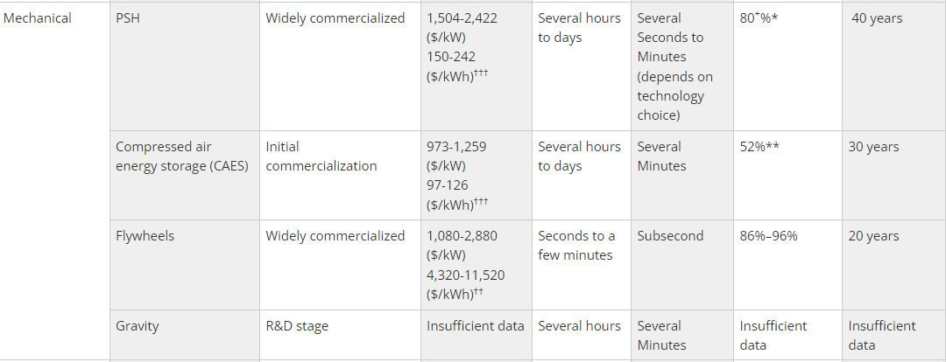

Slide 63
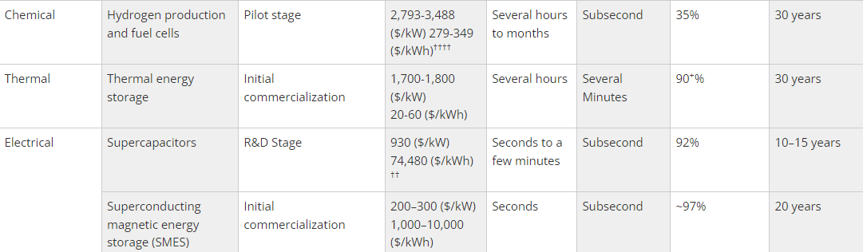

Slide 64
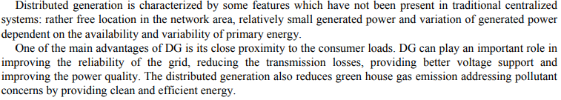
DG Impact on - Transmission and Distribution systems

Slide 65


Slide 66





Slide 67





Slide 68

Deregulation
What is Market Structure?

Slide 69


Slide 70


Slide 71


Slide 72


Slide 73


Slide 74


Slide 75


Slide 76


Slide 77


Slide 78


Slide 79


Slide 80


Slide 81


Slide 82


Slide 83


Slide 84


Slide 85


Slide 86


Slide 87


Slide 88


Slide 89


Slide 90



Slide 91


Slide 92


Slide 93



Slide 94


Slide 95


Slide 96
What is a Spot Market?
A spot market is a financial market where financial instruments and commodities are traded for instantaneous delivery. Delivery refers to the physical exchange of a financial instrument or commodity with a cash consideration. The spot market is also known as the cash market or physical market because cash payments are processed immediately, and there is a physical exchange of assets.
In a spot market, delivery and cash payment normally take place on the spot. However, in most organized markets, settlement – which is the transfer of cash and physical delivery of the instrument or commodity – normally takes 2 working days (i.e., T+2). Despite the T+2 settlement date, the contract between the buyer and seller is performed on the spot at the prevailing price and existing quantity.

Slide 97
Characteristics of Spot Markets
Certain features are associated with spot markets. Below are the most apparent:
Transactions are settled at the ruling price known as the spot price or spot rate.
Delivery of the asset takes place immediately or otherwise at T+2.
Transfer of funds is instantaneous; otherwise, settlement can be at T+2.

Slide 98
Types of Spot Markets
There two main types of spot markets – over-the-counter (OTC) and organized market exchange.
1. Over-the-Counter (OTC)
Over-the-counter (OTC) is a place where buyers and sellers meet to trade bilaterally through consensus. There is no third-party supervisor of a transaction or a central exchange institution to regulate the trade. Assets being traded may not be standardized in terms of quantity, price, or other terms, as is the norm on organized exchanges.
2. Market Exchanges
In an organized market exchange, buyers and sellers meet to bid and offer financial instruments and commodities available. Trading can be carried out on an electronic trading platform or a trading floor. Electronic trading platforms have made trading more efficient, where prices are determined instantaneously.

Slide 99
Advantages of Spot Markets
Spot markets facilitate trading in a transparent environment, where transactions occur at prevailing prices that are public information and known to all parties. Basically, it is easier to execute spot market contracts.
Traders in spot markets can hold and find a better deal if they are not satisfied with current prices and terms.
Trades are done and completed on the spot.
There may be no minimum capital requirements in spot market transactions compared to some contracts on the futures market that have minimum investment amounts for a single contract.

Slide 100
Forward Market
A forward market is a marketplace that offers financial instruments that are priced in advance for future delivery. It tends to be referenced as the foreign exchange market, but it can also apply to securities, commodities, and interest rates
Forward markets facilitate the exchange of forward and futures contracts, setting the price of a delivered asset or financial instrument.
Forward contract pricing is based on the difference in interest rates between two currencies being traded, particularly within FX.

Slide 101



Slide 102



Slide 103


Slide 104
Impact of distributed generation penetration in deregulated electricity market
In transmission and distribution, liberalization played a very important role which led restructuring of the electricity sector from traditional vertical utilities into new different participants devoted to specific activities such as generation and retailing.
Due to deregulation in electricity supply system, new structure and new relation set up between the participants to enhance progressive decoupling such as the flow of money and flow electricity power
In the deregulated electricity market, companies want maximum benefits as well as security from cheaper source. Such situation creates extra burden on supply system in term of overloading and congestions of a particular corridors by which the transmission network is affected.
Excessive use may violate line flow, which would be a dangerous practice leading to voltage instability and thus further weakening system security.
Therefore, the system can be adequately exploited and their available transfer needs to be determined, so that available transfer capabilities ensure the reliability of the system can be maintained.

Slide 105
Due to the factors, such as market liberalization, increased customer demand, development of new technologies, constraints without effecting new transmission line and changing climate, resulted a new interest in distribution generations.
There are open options for market players to select suitable DG technology in changing market condition by the flexible ways. Due to enhancement and innovation of technology, flexible DG has more options in liberalized electricity market.
Changing economic environment also boost the flexible DGs market. As there is small size and less period of construction of DG, it leads more viable and acceptable as compared to large central power plant.

Slide 106
In deregulated electricity market, the system operator must have accurate knowledge about customer and theirs expectations so as to ensure the performance of the power system in the competitive market with acceptable reliability.
The electric utility industry is moving towards competitive market in which it is supposed to ensures customer expectations and system reliability instead of generation and transmission on which focused from few decades.
Congestion management is a big challenge in deregulated electricity market. To overcome these issues in network, a lot of methods are suggested and proposed time to time.
Some viable approach has developed to minimize the price of electricity due to congestion such as spot price methodology for electricity pool market.

Slide 107
Impact of DGs upon protective relaying
The protection of conventional distribution systems is a straightforward task due to their radial configurations with the main source in-feed. In this regard, the protection system in such systems includes fuses, auto reclosers, and overcurrent relays
In the presence of DG, conventional distribution systems would no longer be radially configured, causing many challenges to protection systems which may ultimately lead to losing protection system coordination.
The challenges of the protection systems in the presence of DG would be as listed below : • Unsynchronized reclosing • Avoiding automatic reclosing • Undesired islanding • Contribution to the short-circuit level • Protection system blinding • Nuisance tripping of generating units • Maloperation of feeder protection

Slide 108
DG can cause malfunctioning of protection systems during faults. For instance, if a fault occurs at one of the feeders adjacent to DG units, an undesired tripping command by protection relays may be triggered.
As such, it should be noted that the location of DG units in distribution systems (as well as their number and penetration level), highly impacts protection systems
Overcurrent relays are the most commonly used as primary protection in distribution systems and in some cases as backup protection in transmission and sub-transmission networks.
In presence of DG, the short-circuit levels would change and some challenging issues would arise. Therefore, adaptive relay coordination is necessary for distribution system protection
The contribution of a single DG unit may not significantly affect the fault current. However, in the case of several DG units connected to the system, the fault current and accordingly the protection system will be highly affected

Slide 109
When using inverse time overcurrent protection, the fault-clearing time may become unacceptably long.
The rise in the short circuit level and change in the direction of fault current flow in the distribution network influence the protection coordination between relays installed in the distribution network(DN), and thus disturb the functionality, selectivity and reliability of protection scheme.
Losing protection coordination with DG mainly results in the false tripping command and blinding of the protection system. The protection system becomes blind when the sensitivity of relays decreases, and the false tripping command occurs when the protective device sends a tripping command for a fault on a feeder while the fault has occurred on another feeder
The contribution of a DG unit to a fault current is related to the type of DG unit, which can be characterized as synchronous generators, induction generators and inverter-based units. However, the response of each type to a fault and its contribution to the fault current varies.

Slide 110

Table 1. Contribution of Different DG types to Fault Current

Slide 111
Fault Level: The connection of a DG to a distribution network will inevitably result in some local changes to the characteristics of the network. Connecting a generator to a distribution network has the effect of increasing the fault levels in the network close to the point of connection. The connection of distributed generation to the network could cause a distribution network, which happens to be close to its fault level limit, to exceed it. The risks when fault levels are exceeded will cause damage and failure of the plant, with consequent risk of injury to personnel and interruption to supplies. The new fault current and setting should be calculated for the protection equipment in the system.
Reverse Power Flow: Radial distribution networks are usually designed for unidirectional power flow, from the in feed downstream to the loads. This assumption is reflected in standard protection schemes with directional over current relays. The load flow situation may change with a generation on the distribution feeder. If the local production exceeds the local consumption, the power flow will change the direction. Reverse power flow is problematic if it is not considered in the protection system design.

Slide 112
Islanding: Islanding occurs when a portion of the distribution system becomes electrically isolated from the remainder of the power system, yet continues to be energized by DG connected to the isolated subsystem. Distribution networks with DG are presently not designed to operate in island mode. If unplanned islanding occurs it presents a number of hazards and thus need to be avoided.
Protection Coordination: Faults are eliminated in the smallest possible time, isolating the smallest part of the system containing the cause of the fault. The presence of distributed generation may cause coordination problem, such that more area will be isolated.
Blinding of Protection: Blinding of protection is also called protection under reach. The distributed generation is supplying energy locally to load. As a result the fault current seen by the relay is reduced. The result is that the relay fails to trip.
Sympathetic Tripping: Sympathetic tripping is an expression given to the case at which one of the protection devices trips instead of the other. This tripping occurs due to one device detecting the fault while it is out of its local protection area and tripping before the required tripping device. The protective device operates unnecessary for faults in another protection zone. As a result the healthy feeder gets tripped.

Slide 113



Slide 114
Impact of distributed generation penetration on Stability
Power system stability is the ability of an electric power system, for a given initial operating condition, to regain a state of operating equilibrium after being subjected to a physical disturbance, with most system variables bounded so that practically the entire system remains intact.
Three categories have been proposed, i.e., rotor angle stability, voltage stability and frequency stability.
Rotor Angle Stability: Rotor angle stability refers to the ability of synchronous machines of an interconnected power system to remain in synchronism after being subjected to a disturbance. It depends on the ability to maintain/restore equilibrium between electromagnetic torque and mechanical torque of each synchronous machine in the system. Instability that may result occurs in the form of increasing angular swings of some generators leading to their loss of synchronism with other generators

Slide 115
Voltage Stability :
Voltage stability refers to the ability of a power system to maintain steady voltages at all buses in the system after being subjected to a disturbance from a given initial operating condition.
It depends on the ability to maintain/restore equilibrium between load demand and load supply from the power system.
Instability that may results occurs in the form of a progressive fall or rise of voltages of some buses.
A possible outcome of voltage instability is loss of load in an area, or tripping of transmission lines and other elements by their protective systems leading to cascading outages

Slide 116
Frequency Stability
Frequency stability refers to the ability of a power system to maintain steady frequency following a severe system upset resulting in a significant imbalance between generation and load.
It depends on the ability to maintain/restore equilibrium between system generation and load, with minimum unintentional loss of load.
Instability that may result occurs in the form of sustained frequency swings leading to tripping of generating units and/or loads

Slide 117
It is well recognized that the system steady state voltage rise plays an important role on limiting the penetration level of DG. Thus many methods are proposed to cope with this voltage rise effect:
• if available, tuning the OLTC at the CCP of the transmission and distribution system; • adopting shunt compensating devices to adjust the reactive power injection;
• when necessary, curtailing the power generation of DG;
• implementing load control;
• selecting proper connection point for DG;
• changing line impedance

Slide 118
In general the integration of DG improves the voltage stability of the distribution system.
DG operation mode has a great influence on the improvement of the voltage stability. The greatest improvement is obtained when the DG is operated under the constant nodal voltage mode.
With the increased power level of DG to the network causes the increased in the rotor angle difference of two machines. The transient stability of the system is decreased with increasing penetration level of DG to the network.
The impact of DG at low percentage level of penetration on the distribution network may not be considered as significant, but as its penetration increases, the impact will not only affect the distribution network but also influences the entire network

